Slide 1


U.S. Income Inequality
OLLI, Santa Clara University
May 15, 2019

Slide 2
National Economic Education Delegation
Vision
  One day, the public discussion of policy issues will be grounded in an accurate perception of the underlying economic principles and data.
Mission
  NEED unites the skills and knowledge of a
  vast network of professional economists to promote understanding of the economics of policy issues in the United States
NEED Presentations
  Are nonpartisan and intended to reflect the consensus of the economics profession

Slide 3
Credits and Disclaimer
This slide deck was authored by:
  Jon Haveman, Executive Director of NEED
This slide deck was reviewed by:
  Timothy Smeeding, University of Wisconsin
  Robert Wright, Augustana University
Disclaimer
  NEED presentations are designed to be nonpartisan
  It is, however, inevitable that the presenter will be asked for and will provide their own views.
  Such views are those of the presenter and not necessarily those of the National Economic Education Delegation (NEED).

Slide 4
Outline
Definition (Last Week)
Measurement (Last Week)
How does it happen? (Last Week)
What happened? (Today)
Does it matter? (Today)
Is it a problem? (Today)
What to do about it (Today)

Slide 5
Where Does Inequality Come From?
Labor Characteristics
  Demographics
  Personal Choices
  Immigration
Market Forces
  Technology
  Changing demand patterns
  Competition for labor
Government Policy
  Market influence
  Redistribution

Slide 6
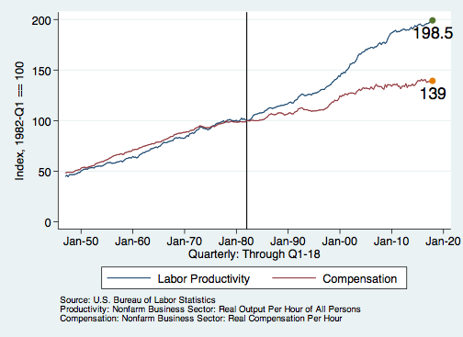
Labor Income is Unhinged from Productivity
Why?
Declining unionization
Globalization
Immigration
Competition policy
Cheap technology

Slide 7
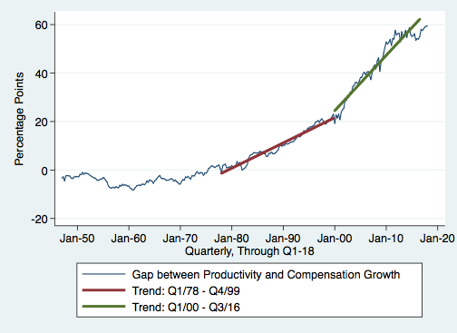
Labor Share Gap Acceleration

Slide 8
Declining Unionization
Unionization Rates
1983: 20.1%
2017: 10.7%
Source: Jason Furman, ”Forms and sources of inequality in the United States”, VOX, March 17, 2016, Figure 4.
Notes:
https://voxeu.org/article/forms-and-sources-inequality-united-states

Slide 9
Competition in the Economy
Return on invested capital excluding goodwill –
US publicly-traded nonfinancial firms, 1965-2014
Source: Jason Furman, ”Forms and sources of inequality in the United States”, VOX, March 17, 2016, Figure 6.
Notes:
Note: The return on invested capital definition is based on Koller et al (2015), and the data presented here are updated and augmented versions of the figures presented in Chapter 6 of that volume. The McKinsey data includes McKinsey analysis of Standard & Poor’s data and exclude financial firms from the analysis because of the practical complexities of computing returns on invested capital for such firms. ​
Source: Koller et al. (2015); McKinsey & Company; Furman and Orszag (2015). , by way of https://voxeu.org/article/forms-and-sources-inequality-united-states
Furman, J and P Orszag (2015), “A Firm-Level Perspective on the Role of Rents in the Rise in Inequality”, Presentation at “A Just Society” Centennial Event in Honor of Joseph Stiglitz Columbia University, October 16, 2015.

Slide 10
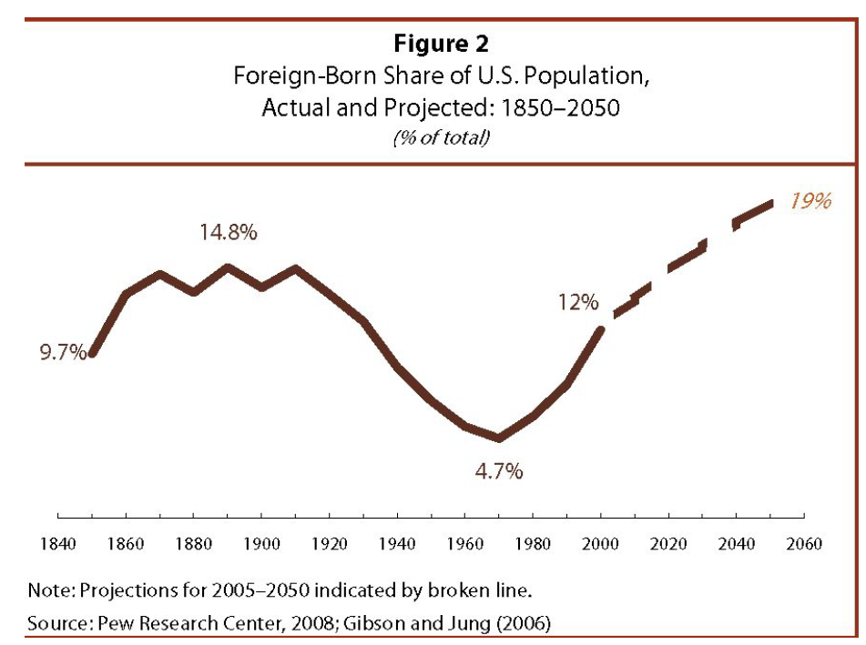
Immigration

Slide 11
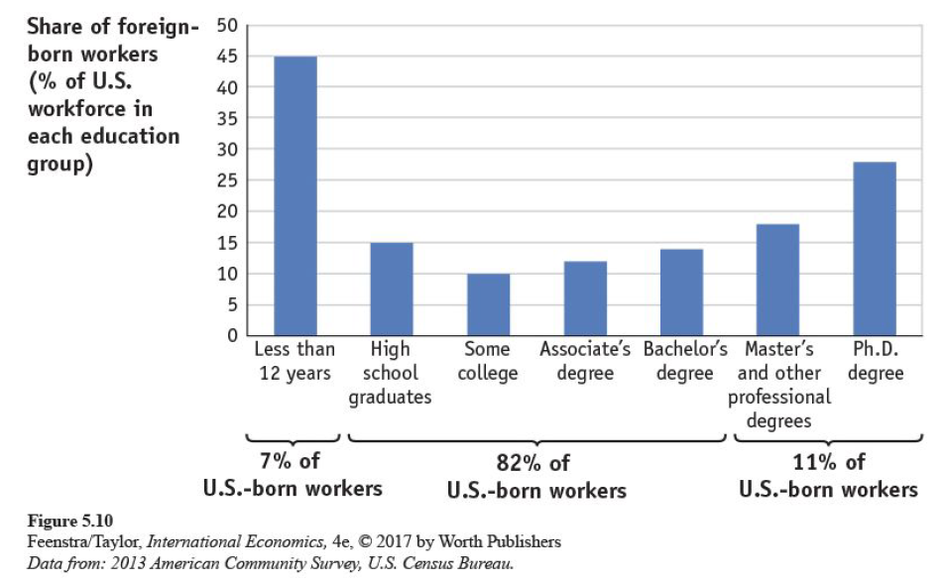
Immigration

Slide 12
Immigration and Inequality
Source: Ping Xu, James C. Garand, and Ling Zhu, “How immigration makes income inequality worse in the U.S.”, October, 2015, Figure 1.

Slide 13
Immigration and Inequality- Summary
Beginning in about 1970, the immigrant share of the U.S. Population increased dramatically.
  5% in 1970 and 14% in 2016
Immigration tends to happen most often among:
  Low-skilled low-wage workers
  High-skilled high-wage workers
Immigration has likely increased income inequality.
Its effect has likely been small.
  ~5% between 1980 and 2000
  No reason to think it has been bigger since

Slide 14
Technological Change and Inequality
Much of the technology adopted in the last 30 years has eliminated low-skill or low-wage jobs.
  Computers, advanced manufacturing equipment, steel mini-mills, automation
There is a “winner take all” aspect of the technology-driven economy.
  This potentially favors a small group of individuals.
Both aspects increase inequality by increasing the rewards to:
  Those with significant labor market skills
  Owners over workers

Slide 15
Technology Benefits Ownership over Labor

Slide 16
Globalization
What is globalization?
  Flow of goods, services, capital, and labor across international borders
How does it affect inequality?
  Through a differential impact on low skilled workers and hence their wages
  For the United States, globalization is thought to lower the wages of low skilled and hence low wage workers relative to those of high skilled workers

Slide 17
Mechanisms for the Effects of Globalization
Merchandise trade
  Importing goods that are made with low-skilled workers and exporting goods that are made with high-skilled workers
    Should lower the wages of unskilled relative to skilled, making the distribution of income less equal
Outsourcing
  Similar channel as with merchandise trade
Trade in services
  US imports of middle-skill services: business and some professional services

Slide 18
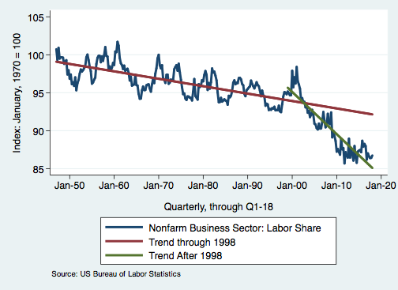
Effects of the Unhinging?

Slide 19
What is driving increasing inequality?
Primary drivers:
  Technology
  Globalization
  Institutions
These drivers can also influence personal choices in ways that affect measured income inequality.
  For example, educational choices or labor force participation.

Slide 20
Sources of Inequality Through Late 1990s

Slide 21

Why Does Inequality Matter?
Too little inequality can:
  Reduce individual motivation
  Slow economic growth
Too much inequality can:
  Slow growth
  Reduce individual motivation
Too much inequality may also:
  Divide society
  Distort political environment
  Reduce political participation
  Reduce investments in public goods
    Education
    Environmental protections

Slide 22
How Much Inequality Is too Much?
?
?
Equity
Efficiency
Efficiency
Equity
Efficiency
Equity
0
100
Z’’
Z
Z’
X
Gini Coefficient

Slide 23
An International Perspective
Source: Data taken from the 2014 CIA World Factbook.

Slide 24
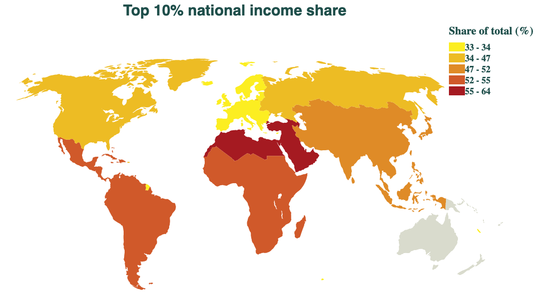
An International Perspective (Year: 2016)
Source: Data taken from www.wid.world.

Slide 25
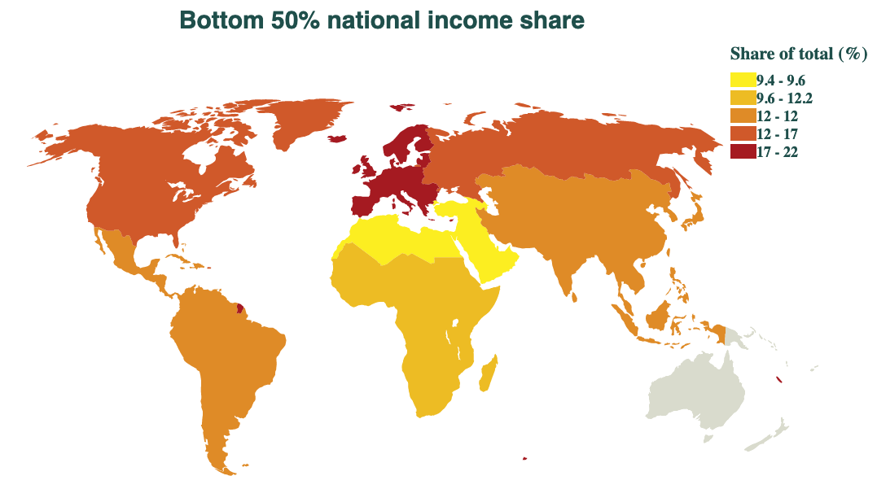
An International Perspective (Year: 2016)
Source: Data taken from www.wid.world.

Slide 26
An International Perspective: Comparables

Slide 27
But the High-Income Households Save More
Facilitates the Consumption of:
Wealth
Which facilitates the consumption of:
Leisure

Slide 28
Addressing Inequality: Is It A Problem?
Why it might be a problem.
  Economic issues (Efficiency)
    There is evidence that at some level, increased inequality slows economic growth.
    Or, inequality concentrates resources among investors.
  Noneconomic issues (Equity)
    Values, ethics and morals will drive individual evaluations of the level of inequality.
      E.g., inequality is primarily a function of market outcomes, so should be left alone.
      Or, a solid middle class is important for maintaining a civil society, which runs contrary to a high degree of inequality.
Suppose you think it’s a problem. How might it be addressed?

Slide 29

Addressing Inequality:
Immediately Available Policy Solutions (1/2)
Redistribution
  Tax and transfer programs
PRE-distribution
  Strengthen labor unions
  Minimum wages
  Collective bargaining
  Other policies that favor labor over business owners

Slide 30
Tax and Transfer Programs and Inequality
2014
Source: U.S. Congressional Budget Office, “The Distribution of Household Income, 2014”, Average Income Before and After Means-Tested Transfers and
Federal Taxes, by Income Group, 2014.

Slide 31
Addressing Inequality:
Immediately Available Policy Solutions (2/2)
Other
  Reverse trends in market power
Locally
  Employment services: job training, interview skills, or assistance with day-to-day issues, such as child care
  Cognizance of the potential for technologies to affect worker/employer power dynamics
    Uber, Lyft, etc.
Notes:
Reference your own experience at FTC

Slide 32
Addressing Inequality:
Long Term
It’s all about access to resources:
  Education, in particular
    Improve public education
    Reduce disparities in quality of public education
    Improve counseling in low-income schools
      With respect to college – paths to success and funding
  Investments are needed in early education, not later
    Universal pre-K
    Upgrade quality of elementary schools in low-income areas

Slide 33
What to do About Inequality?
Nothing?
Redistribution?
PRE-distribution?
Access to resources?

Slide 34
Tension in Policy Solutions
Is it possible to increase growth at the same time that you reduce income inequality?
  Common refrain among some that government intervention in the economy is always and everywhere bad for growth.
Possibly: expanding equality of access promotes the full utilization of resources.
  Expanding equality of access requires resources likely from the well-to-do.

Slide 35
Summary
Income inequality is clearly increasing.
  The economy is clearly favoring owners of productive resources over labor.
The causes appear to be largely driven by:
  The market – technology, trade, and competition
  Changing institutions
Open questions are:
  To act or not to act?
  If so, how?

